Slide 1

Welcome

Slide 2
Business Process Automation
Day – 04
Part 2
:p

Slide 3
What we will do today
Introducing the Modern and Classic Design Experiences

Slide 4
What we will learn
State and define the design experiences UiPath Studio offers.
Change the default design experience at Studio level.
Change the design experience at Project level.
Explain key differences between the classic design experience and the modern design experience.

Slide 5
What are design experiences?
UiPath Studio offers two ways of developing UI Automation:
The Modern Design Experience
The Classic Design Experience

Slide 6
What are design experiences?
These design experiences help developers adapt to different contexts while building the UI Automation.
The default design experience in Studio is Modern Design Experience.
We can change the design experience based on the requirement, in two ways:
Change the default design experience at Studio level.
Change the design experience at Project level.

Slide 7
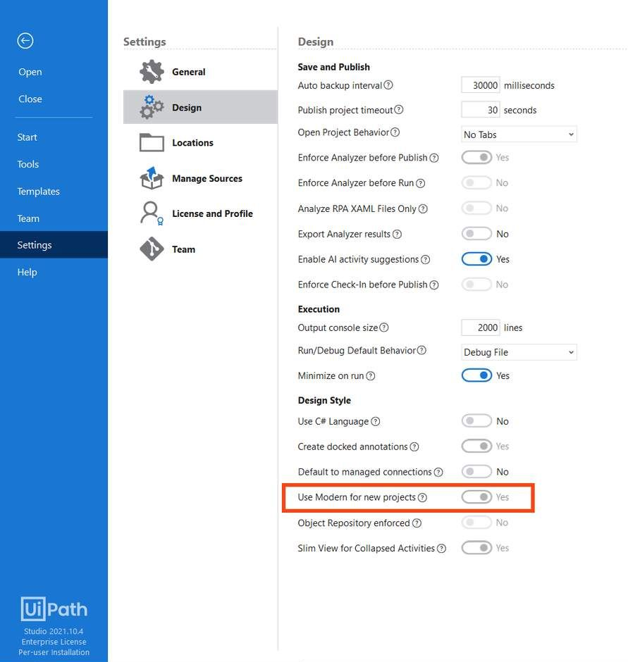
Change the default design experience at Studio level
For all new projects, we can set this from Backstage View.
Backstage View > Settings > Design.

Slide 8
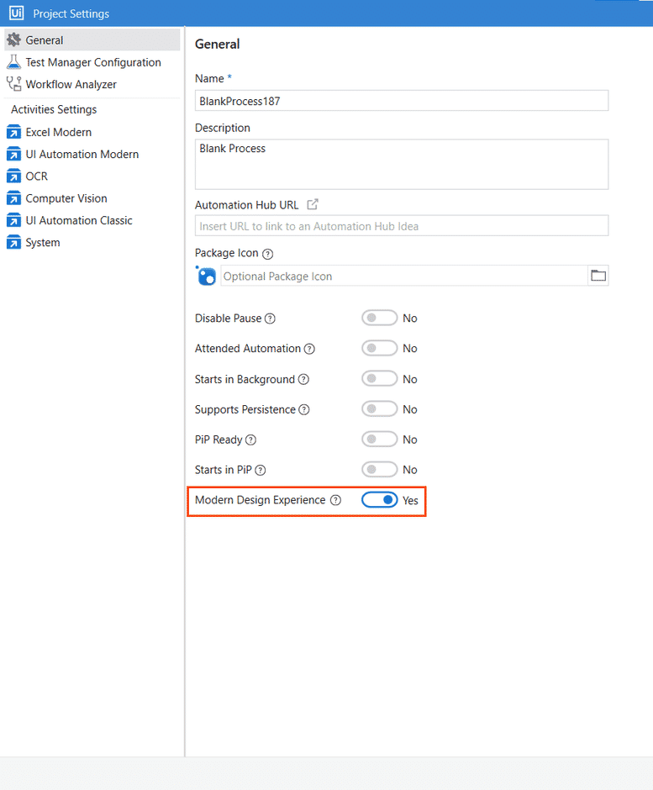
Change the design experience at Project level
The default design experience is set at project level from Project Settings or for all new projects from the Project tab.
Project tab > Project Settings > General.

Slide 9
What are the differences?
The key differences between the modern design experience and the classic design experience are based on the following key concepts:
UI Automation activities
Activity properties
Targeting methods
Input methods
Recorders and Scarping wizards
The object repository

Slide 10
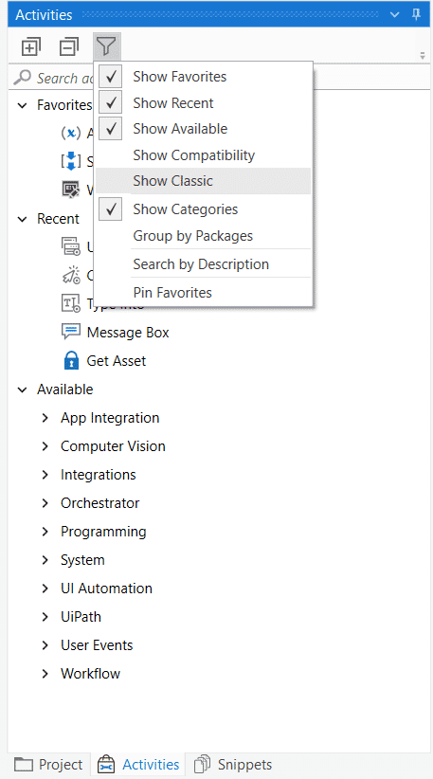
UI Automation activities
A separate set of UI activities is available by default in each experience.
Regardless of the selected experience of an automation project, modern or classic, the other set of activities can be enabled.
The default experience is Modern. To view the classic activities simply select the "Show Classic" from the Activities panel, or vice versa.

Slide 11
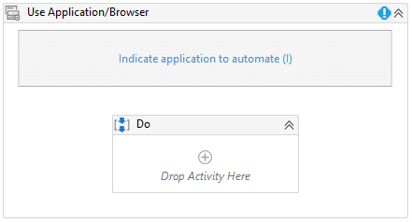
A great example would be
Use Application/Browser modern activity which replaces the following Classic Activities:
Open Application
Open Browser
Attach Window
Attach Browser
Element Scope
Close Window
Start Process
Note that modern activities only work within containers, while classic activities can be configured to work without containers as well.

Slide 12
Activity properties
Modern and Classic activities have slightly different properties because of different targeting methods and Activity behaviors. We'll learn more about this in the following lessons.

Slide 13
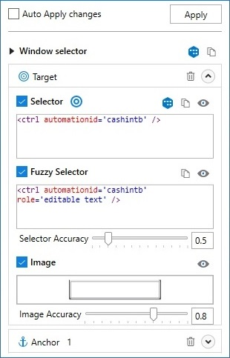
Targeting methods
Modern activities will cycle through the stacked options Selector, Fuzzy Selector, and Image to determine the most reliable option.
This targeting technology is called Unified Targeting method.
Modern Design also uses Native Text targeting method.
It helps to automate legacy applications, in which UI elements aren't correctly defined.
When using classic activities, the selector is the most common targeting method for UI elements (99% of the time).
In scenarios where it's unreliable, you have the possibility to manually change the update Activity to use fuzzy selectors or anchors.

Slide 14
Input methods
Both design experiences use input methods (Hardware events, SendWindowMessages, and Simulate). A new input method, ChromiumAPI, is used in the modern experience.

Slide 15
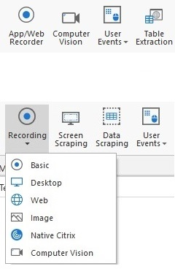
Recorders and wizards
Modern and classic offer two different sets of recorders:
Modern experience - The App/Web and Computer Vision recorders are available.
Classic experience - The Basic, Desktop, Web, Image, Native Citrix, and Computer Vision recorders are available.
When it comes to Scraping Wizards
Modern experience - The Table Extraction wizard is available for data scraping.
Classic experience - The Data Scraping and Screen Scraping wizards are available.

Slide 16
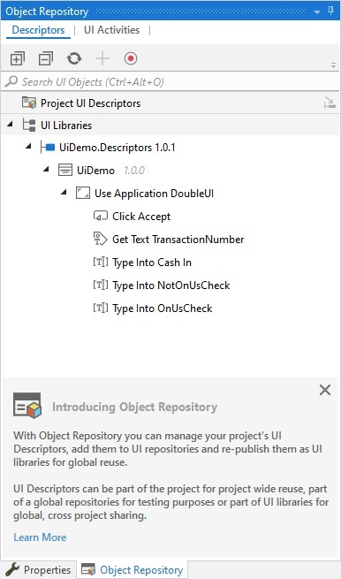
The object repository
The Object Repository ensures the management, reusability, and reliability of UI elements by capturing them as objects in a repository, sharable across projects.
The Object Repository is only available in the Modern Design Experience.
Don't worry about remembering all of this.
It's useful to know what the key areas of difference are and you can reference this course later if you need to.

Slide 17
Main takeaways
There are two UI Automation design experiences in UiPath Studio: modern and classic.
The default experience is modern. This can be changed at project level or for all new projects.
The two experiences differ on:
Activities: Both experiences provide different activities, but you can filter the Activities pane to see the ones from the non-default experience.
Activity properties: The properties are slightly different between the Modern and Classic activities.
Targeting methods: Modern uses Unified Target (a stack of Selector, Fuzzy Selector, and Image) and Native Text, while Classic uses mostly selectors.
Input Methods: Modern uses Hardware Events, SendWindowMessage, Simulate and ChromiumAPI, while Classic uses Hardware Events, SendWindowMessage, Simulate.
Recorders: Modern offers a simplified recording solution with two recorders, while classic offers six recorders.
Scraping wizards: Modern offers the Table Extraction wizard while classic offers the Data Scraping and Screen Scraping wizards.
Object repository: the object repository is only available to the modern design experience.

Slide 18
UI Automation Hands on !!

Slide 19
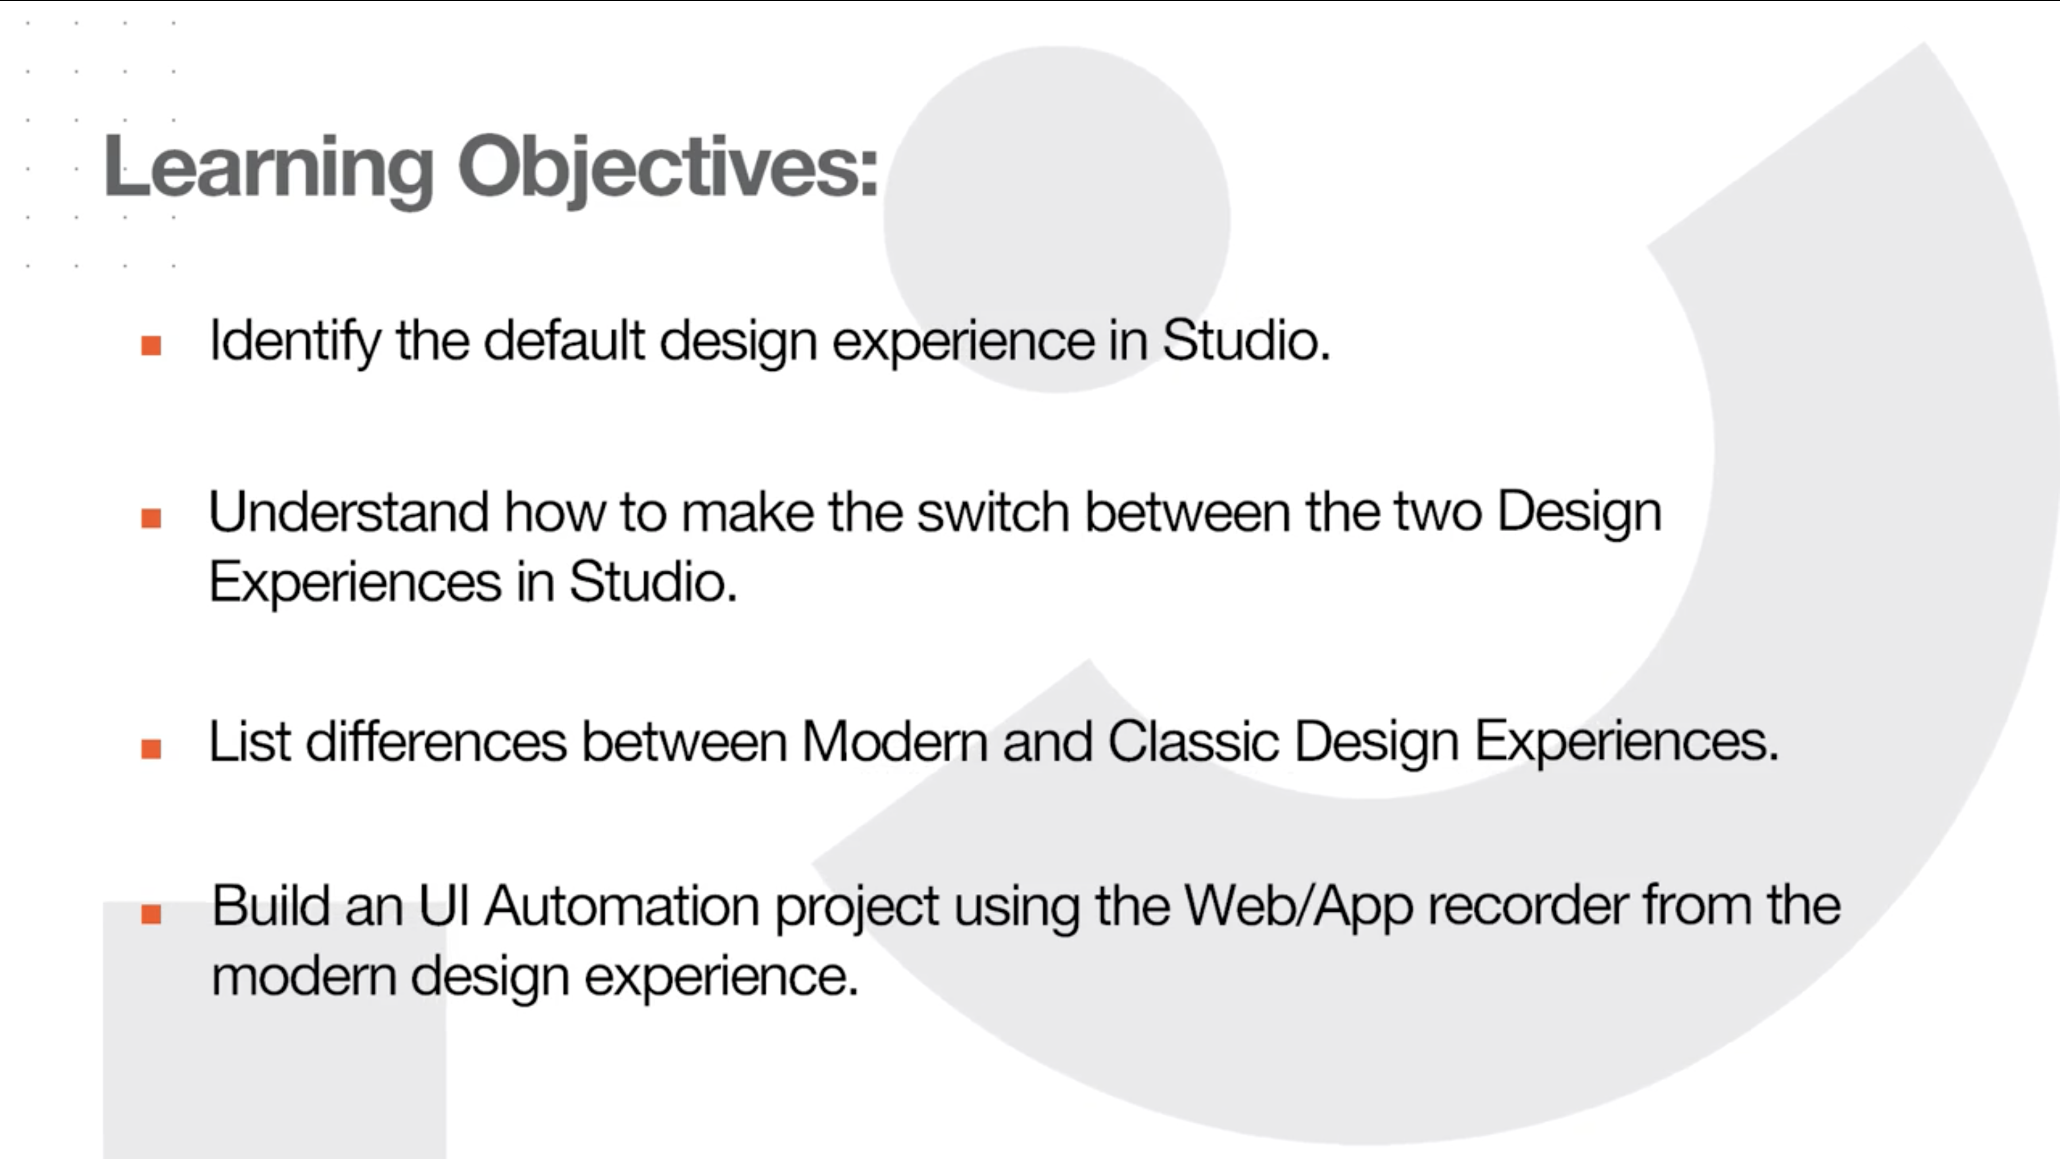

Slide 20
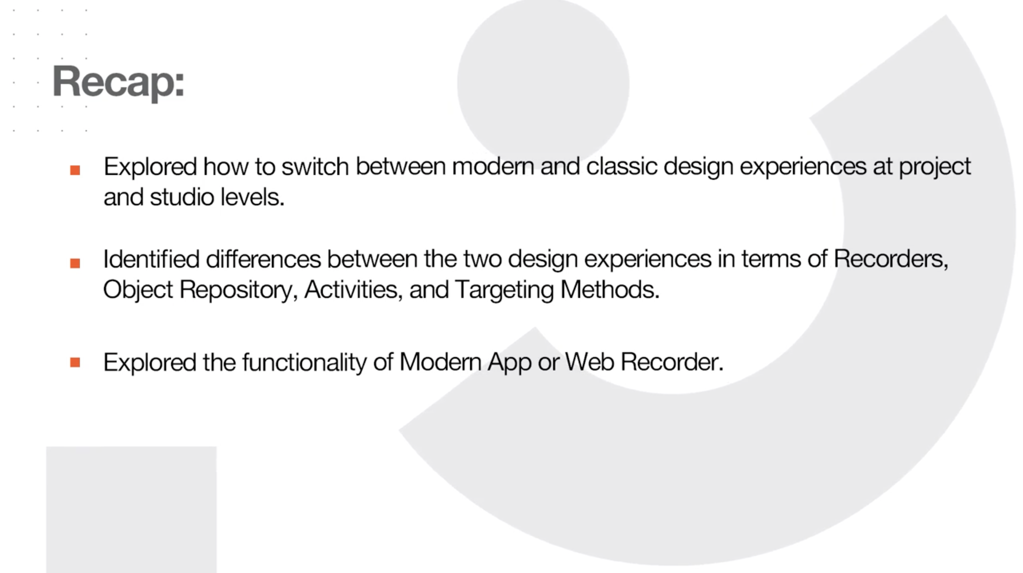

Slide 21

That’s it

Slide 22

Thanks

